Slide 1
Observer design pattern

Slide 2


Our team
Nguyễn Hoàng Khôi
Vương Quốc Ấn
10421030
10421002

Slide 3
Table of contents
01
02
03
04
Overview
Definition
Benefit
Demonstration

Slide 4
01
Overview

Slide 5
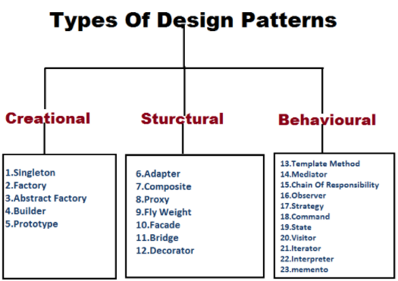
- Design pattern are categorized into 3 main groups
- Observer pattern is a Behavioural pattern

Slide 6
02
Definition

Slide 7
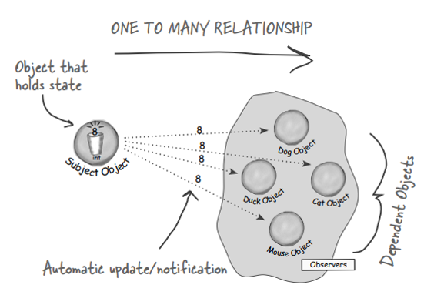

Slide 8
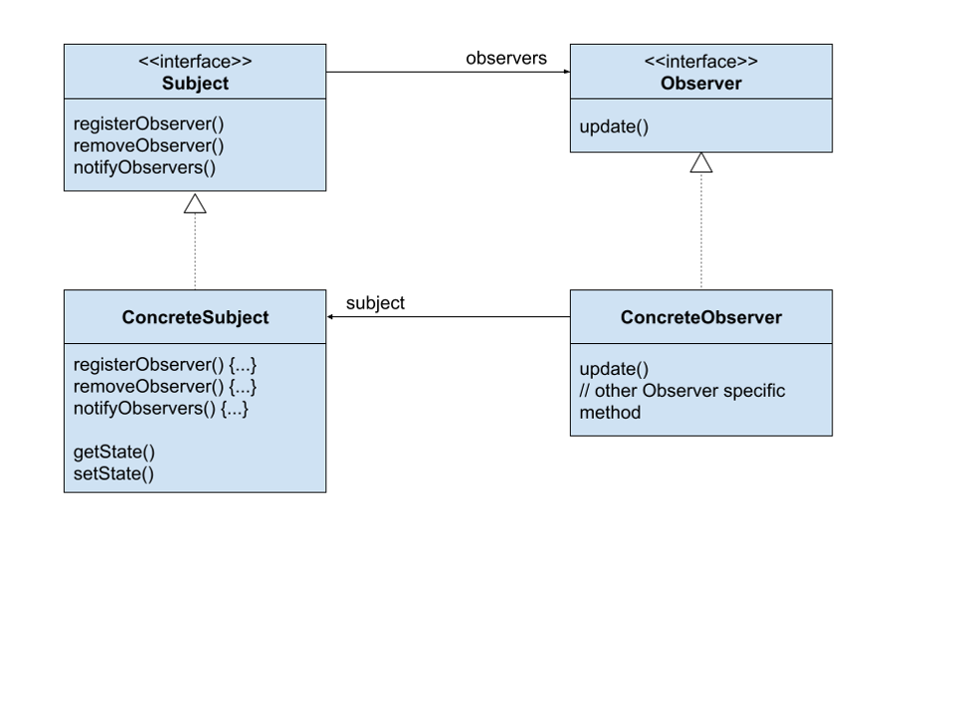
Class Diagram

Slide 9
03
Benefit

Slide 10
Benfits
01.
02.
03.
Subject does not need to know the concrete class of an observer
Can add new observers at any time
Observers can be added without modifying the subject
04.
05.
Can reuse subjects or observer independently
Changes to either wil not affect the other

Slide 11
04
Demo
Designing the Weather Station

Slide 12
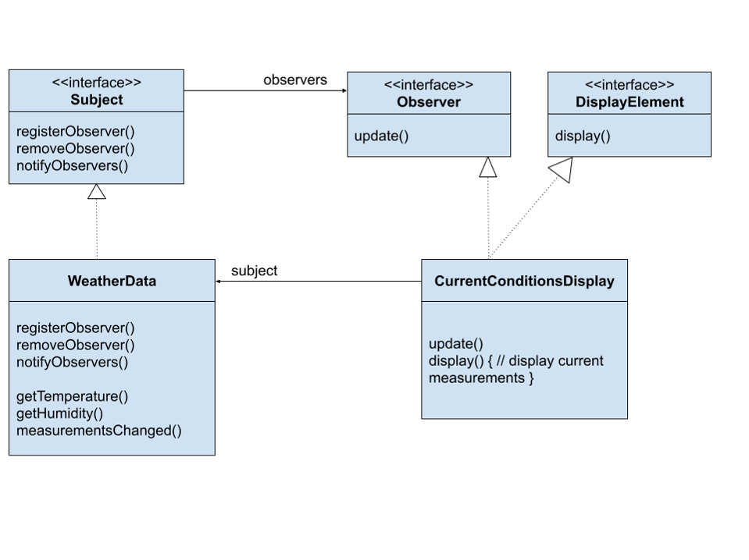
Class Diagram

Slide 13
Thank You

